Slide 1
Cognitive scientists (scientists who study how people learn) have shown that physics students come into physics class with a set of beliefs that they are unwilling (or not easily willing) to discard despite evidence to the contrary. These beliefs about motion (known as misconceptions) hinder further learning. The task of overcoming misconceptions involves becoming aware of the misconceptions, considering alternative conceptions or explanations, making a personal evaluation of the two competing ideas and adopting a new conception that is more reasonable than the previously held-misconception. This process involves self-reflection (to ponder your own belief systems), critical thinking (to analyze the reasonableness of two competing ideas), and evaluation (to select the most reasonable and harmonious model that explains the world of motion). Self-reflection, critical thinking, and evaluation. While this process may seem terribly complicated, it is simply a matter of using your brain.

Slide 2
Newton’s Laws
FORCE AND MOTION

Slide 3
What do you think?
An object’s ________ is most closely linked to the size of the net (vector sum) force acting on an object.
  a) position b) displacement
  c) velocity d) acceleration
An object will move at a constant velocity if:
a) a constant net force acts
b) no net force acts
To make an object move to the right and speed up the same amount each second requires a net force that is…

Slide 4
What do you think?
Imagine a place in the cosmos far from all gravitational and frictional influences. Imagine that you visit that place and throw a rock. The rock will:
gradually stop.
continue in motion in the same direction at constant speed.
This prediction cannot be made

Slide 5
What do you think?
Supposing you were in space in a weightless environment, would it require a force to set an object in motion?

Slide 6
Newton’s 1st Law
An object at rest will remain at rest, and an object in motion will remain in motion at a _ _ _ _ _ _ _ _ _ _ _ _ _ _ _ _ unless it is acted upon by a _ _ _ force.
If … then…
If … then…

Slide 7
Newton’s 1st Law
An object at rest will remain at rest, and an object in motion will remain in motion at a CONSTANT VELOCITY unless it is acted upon by a NET (external) force.
If ΣF = 0 then a=0
If ΣF ≠ 0 then a≠0 (acceleration occurs)

Slide 8
Newton’s 1st Law CYU
Cars had no seatbelts in the 1950’s. Then, if a car ran into a rigid obstruction (like a tree) the passengers….
were thrown forward.
continued forward.
were thrown backward.

Slide 9
Newton’s 1st Law CYU
In a head on collision, the job of the seatbelt is to…
balance the forces on the passenger.
exert an unbalanced force on the passenger, toward the back of the car.
exert an unbalanced force on the passenger toward the front of the car.

Slide 10
The job of a head rest:
A head “rest” does its job when a car is struck from behind. In this type of accident, the headrest must:
Balance the forces on the person’s head to…
Exert a net force on the person’s head toward the front of the car to…
Exert a net force on the person’s head toward the rear of the car to…

Slide 11
Newton’s 1st Law, or the Law of…
INERTIA

Slide 12
Inertia!
What is it?
Can it be measured?
Does it have units?

Slide 13
The numerical measure of inertia is…

Slide 14
The numerical measure of inertia is:
MASS

Slide 15
Mass is NOT:
weight
a force
a vector
volume

Slide 16
The Inertial Balance
What does it “measure”?
Where can it be used?

Slide 17
So, mass…
…is the measure of______________________
Doesn’t that mean mass affects acceleration?
Can you ask:
What is the mathematical relationship between _________________________ (_____) and mass (kg) of an object?

Slide 18
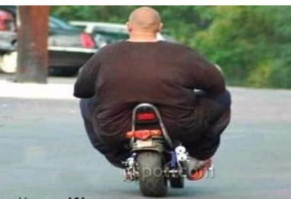
What is the mathematical relationship between an object’s acceleration (m/s/s ) and its total mass (kg)? (Assuming the is kept constant.)

Slide 19
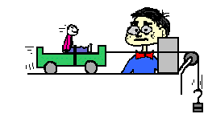
What is the mathematical relationship between an object’s acceleration (m/s/s ) and its total mass (kg)?
(Assuming the net force is kept constant.)

Slide 20
What else will affect acceleration?

Slide 21
What else will affect acceleration?
The size and direction of the NET FORCE
ΣF, or F_{net}

Slide 22
What is net force?

Slide 23
A Net Force is…
The VECTOR SUM of ALL of the forces acting on an object.

Slide 24
What is a Force?
Symbol?
SI unit?
Definition?
Examples? (types of individual forces)

Slide 25
Types of Forces
Type “Agent”
(F_{g}) Gravitational force
(F_{n}) Normal force
(F_{f}) Friction (force)
(F_{a}) Applied force
(F_{t}) Tension (force)
(F_{d}) Drag (force)
(F_{thrust}) Thrust
(F_{lift}) Lift (force)

Slide 26
Types of Forces
Which force is always present for earth-bound objects?
Upon what does it depend?

Slide 27
What is the mathematical relationship between…….

Slide 28
What is the mathematical relationship between…….
an object’s weight in newtons (or the force of gravity on it) and its mass in kilograms?
This is the question we’d like to answer, but…

Slide 29
What is the mathematical relationship between….
the magnitude of the force needed to counter the gravitational force (N) on an object and the mass (kg) of the object?
This is the actual question we will answer. Why is there a difference?

Slide 30
Weight
Weight is defined differently in various texts.
Some say weight is another name for the force of (or due to) gravity.
Some say weight is the force needed to counter the force of gravity to keep an object from accelerating vertically.
  How does one force keep an object from accelerating vertically? In other words, what does counter mean?

Slide 31
Weight
“The force of gravity is the force with which the earth, moon, or other massively large object attracts another object towards itself. By definition, this is the weight of the object. All objects upon earth experience a force of gravity that is directed "downward" towards the center of the earth.” the PCR

Slide 32
Weight
We will say that weight is the size of the gravitational force on an object.
Weight is directly proportional to mass.
F_{g} = mg
  F_{g} = weight, or gravitational force (in newtons)
  m = mass (in kilograms)
  g = acceleration due to gravity, OR free fall acceleration, on earth 9.8m/s/s OR gravitational field strength (9.8 N/kg)
Weight changes with location in the universe.

Slide 33
Practice
What is the weight (in N) of a 30 kg suitcase? (if it is on earth)
An astronaut weighs 700N on Earth. How much does he weigh on the moon (where g=1.6 N/kg)?

Slide 34
Assignment:
Honors Physics
Read PCR Newton’s Laws Lessons 1,2
Complete Quest: Mass, Weight, Force

Slide 35
Types of Forces (a second look)
Type “Agent”
(F_{g}) Gravitational force
(F_{n}) Normal force
(Ff) Friction (force)
(F_{a}) Applied force
(F_{t}) Tension (force)
(F_{d}) Drag (force)
(F_{thrust}) Thrust
(F_{lift}) Lift (force)

Slide 36
What is net force?
The vector sum of all the forces acting on an object – and it is the cause of acceleration.

Slide 37
What is a NET FORCE?
It is NOT a type or example of a force.
It is the VECTOR sum of all the forces (acting on an object).
It is also called the unbalanced force, the sum of the forces, and total force.
Symbols:
  ΣF or F_{net}
  (or just F by lazy teachers and authors)

Slide 38
I am still confused, I can’t visualize forces!
Force cannot be seen!
Many forces can be felt, but only by the objects that are interacting.
We construct Free Body Diagrams (FBD) to assist us.
  Draw a dot or small box to represent the object
  Draw one arrow representing each of the forces acting on the object.
    Draw the arrow in the direction of the force.
    Make the arrow longer for a stronger force.
  3. Label each arrow with an F and subscript.

Slide 39
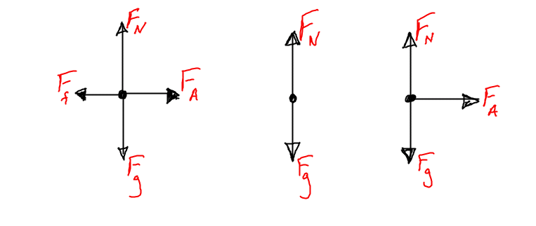
Which FBD is for an object that is NOT MOVING?

Slide 40
Free Body Assignment
Teacher does one example
Students complete all 12 on PCR
In notes (or saved to a flash drive) copy the problem description, the labeled FBD (be sure it is drawn to scale) FOR EACH PROBLEM YOU DIDN’T GET ON THE FIRST TRY.
Complete parts a & b on the WS Net Force & FBD’s

Slide 41
Now, You (might) understand Net Force…
What does a net force cause?

Slide 42
Now you understand Net Force…
Net force is the cause of acceleration. The resulting acceleration is in the direction of the net force, ALWAYS. So, if net force is the cause, and acceleration is the effect, then we must ask….

Slide 43
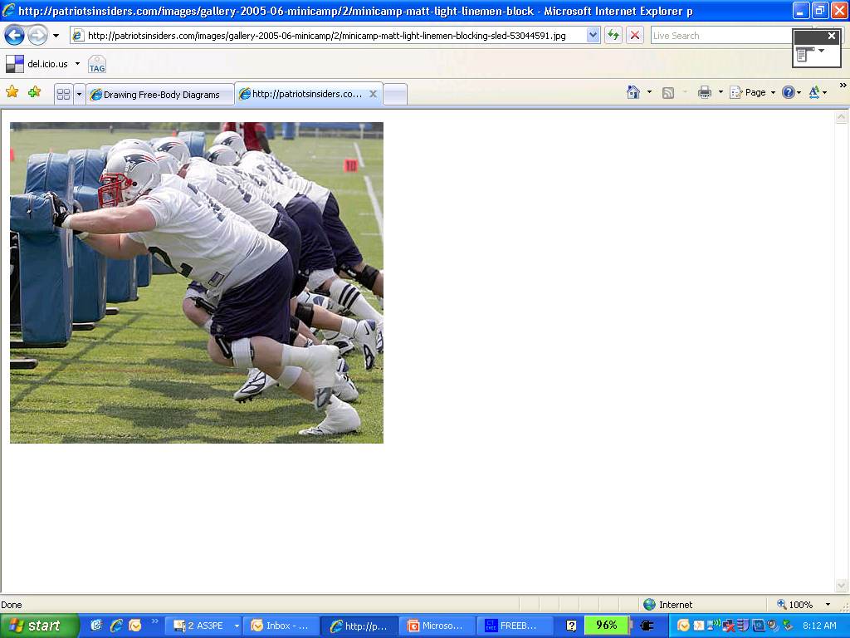
What is the mathematical relationship between an object’s acceleration (m/s/s ) and the net force (N) acting on it? (Assume _ _ _ _ is kept constant.)

Slide 44
What is the mathematical relationship between an object’s acceleration (m/s/s ) and the net force (N) acting on it? (Assume SYSTEM MASS is kept constant.)

Slide 45
Newton’s 2nd Law
Relates net force, mass, acceleration
acceleration = net force / mass
a= ΣF/m a=F_{net}/m ΣF=ma
NOTE: This law focuses on the net force on ONE object and the resulting acceleration of that ONE object.

Slide 46
Ex: Basic Applications of Newton’s 2nd Law
A Tesla S has a mass of 2107kg. What net force is required to accelerate this car to 100 km/hr in 2.36 seconds?
Dennis (67kg) can start from rest and sprint 10.0m in 2.58 seconds. How much (average) net force does this require?
A major league pitch can impact the catcher’s glove traveling at 45.0m/s. The ball is stopped after moving 20.0cm. If the ball is 142g, calculate the magnitude of the net force acting on it during the collision. (Assume the ball slows with a uniform acceleration.)

Slide 47
Assignment
AP
Read p98-105
Study Probs 5, 8, 21, 28 from Chapter 5
Quest Newtons Laws 2
Honors
- Read PCR Newton’s Laws Lessons 1,2,3a,b
- Start Quest Newton’s2nd and 3rd Laws

Slide 48
What about the forces between two objects?
Newton’s 1st Law uses forces to determine if an object _ _ _ _ _ _ _ _ _ _ _
Newton’s 2nd Law relates the acceleration to the net force and mass MATHEMATICALLY
Newton’s Third Law focuses on the size and directions of the forces that are applied when tow objects interact. It does NOT analyze the movement that results form the forces!

Slide 49
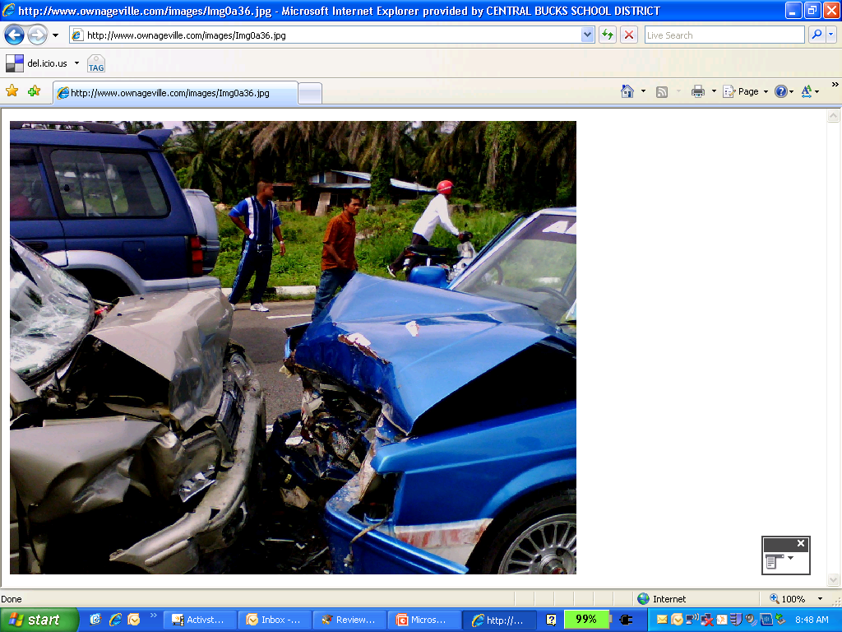

Slide 50
Consider these interactions:
Two things (Thing 1 & Thing 2) of equal mass traveling at equal speeds collide head-on. Who “feels” more force?
Two things (Thing 1 & Thing 2) of equal mass collide, but Thing 2 was initially at rest. Who “feels” more force?
Thing 1 rear-ends Thing 2. Who “feels” more force?

Slide 51
Consider these interactions
Two things (Thing 1 & Thing 3) traveling at equal speeds collide head-on. Thing 3 is WAY more massive. Who “feels” more force?
Two things (Thing 1 & Thing 3) collide, but Thing 1 was initially at rest. Thing 3 is WAY more massive. Who “feels” more force?
Two things (Thing 1 & Thing 3) collide, but Thing 3 was initially at rest. Thing 3 is WAY more massive. Who “feels” more force?

Slide 52
3rd
The force object one exerts on object two is equal size but opposite direction to the force that object two exerts on object one. ALWAYS
(For every action, there is an equal, but opposite reaction.)
Newton’s Third Law focuses on the size and directions of the forces that are applied when two objects interact. It does NOT analyze the type of movement that results form the forces!

Slide 53
Action and Reaction Forces…
Are ALWAYS the same size and opposite directions
Are ALWAYS the same type of forces (if the “action” force is friction, so is the “reaction” force)
NEVER cancel (balance is a better word, but they NEVER do that either!)

Slide 54
The heaviest man ever…
The earth pulled on Jon Minnoch with 4332N of gravitational force. How much gravitational force did Jon exert on the earth?

Slide 55
Ex: Free Body Diagram based 2nd Law Problems
A 300kg elevator is supported by a steel cable. Determine the tension in the cable when the elevator is:
  stationary
  accelerating upward at 0.50m/s/s
  moving upward at a constant 2.0m/s
  slowing down 0.5m/s every second, while still moving upward.

Slide 56
2nd Law Example
A 35 kg child rides in an elevator. How heavy does the child feel (what is the normal force acting on the child) when the elevator is:
accelerating upward at 3.5 m/s/s?
moving upward at a constant 7.0 m/s?
accelerating downward at 3.5 m/s/s?
sitting still?

